Slide 1

Marketing Analytics
Avani Bhojwani

Slide 2
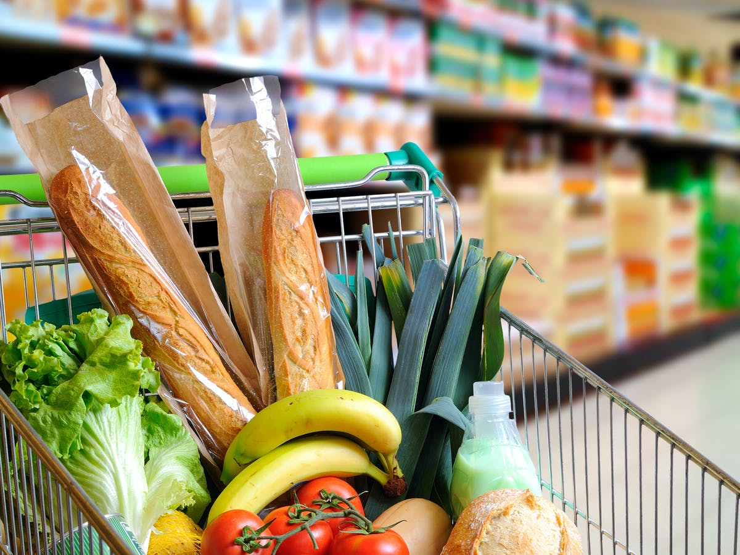
Business context
The Supermarkets and Grocery Stores industry in Australia is the 2nd largest Retail Trade industry in terms of market size
Over $121 billion of revenue per year
Spent over $190 million on advertising, just in the first half of 2021
For each marketing campaign, there’s only a small percentage of customers that respond
https://www.shutterstock.com/image-photo/shopping-cart-full-food-supermarket-aisle-350102345?src=t_AbbjFSKcqkXE94nM589w-1-4&studio=1
Notes:
A response model can provide a significant boost to the efficiency of a marketing campaign by increasing responses or reducing expenses. The objective is to predict who will respond to an offer for a product or service
https://www.ibisworld.com/au/market-size/supermarkets-grocery-stores/
https://mumbrella.com.au/retail-tops-industry-ad-spend-in-first-half-2021-finds-nielsen-ad-intel-694378
https://financesonline.com/food-industry-statistics/
$2.97 billion was spent on ads for grocery stores in 2019. (Schonfeld & Associates, 2020)
Grocery stores hold a 92.4% market share in traditional food store sales. Brandon Gaille)
21% of shoppers frequently use coupons for their food delivery purchases. (Brandon Gaille)
https://www.statista.com/topics/2223/food-advertising/#topicHeader__wrapper
Total ad spend of food industry in the Us in 2019: >240 bn USD
Grocery stores industry ad spend in the US: >246 bn USD
Number of food and beverage ads viewed by adults in the U.S. in 2016
https://www.reportlinker.com/ci02024/Food.html
World food retail sales generate over $4 trillion per year

Slide 3
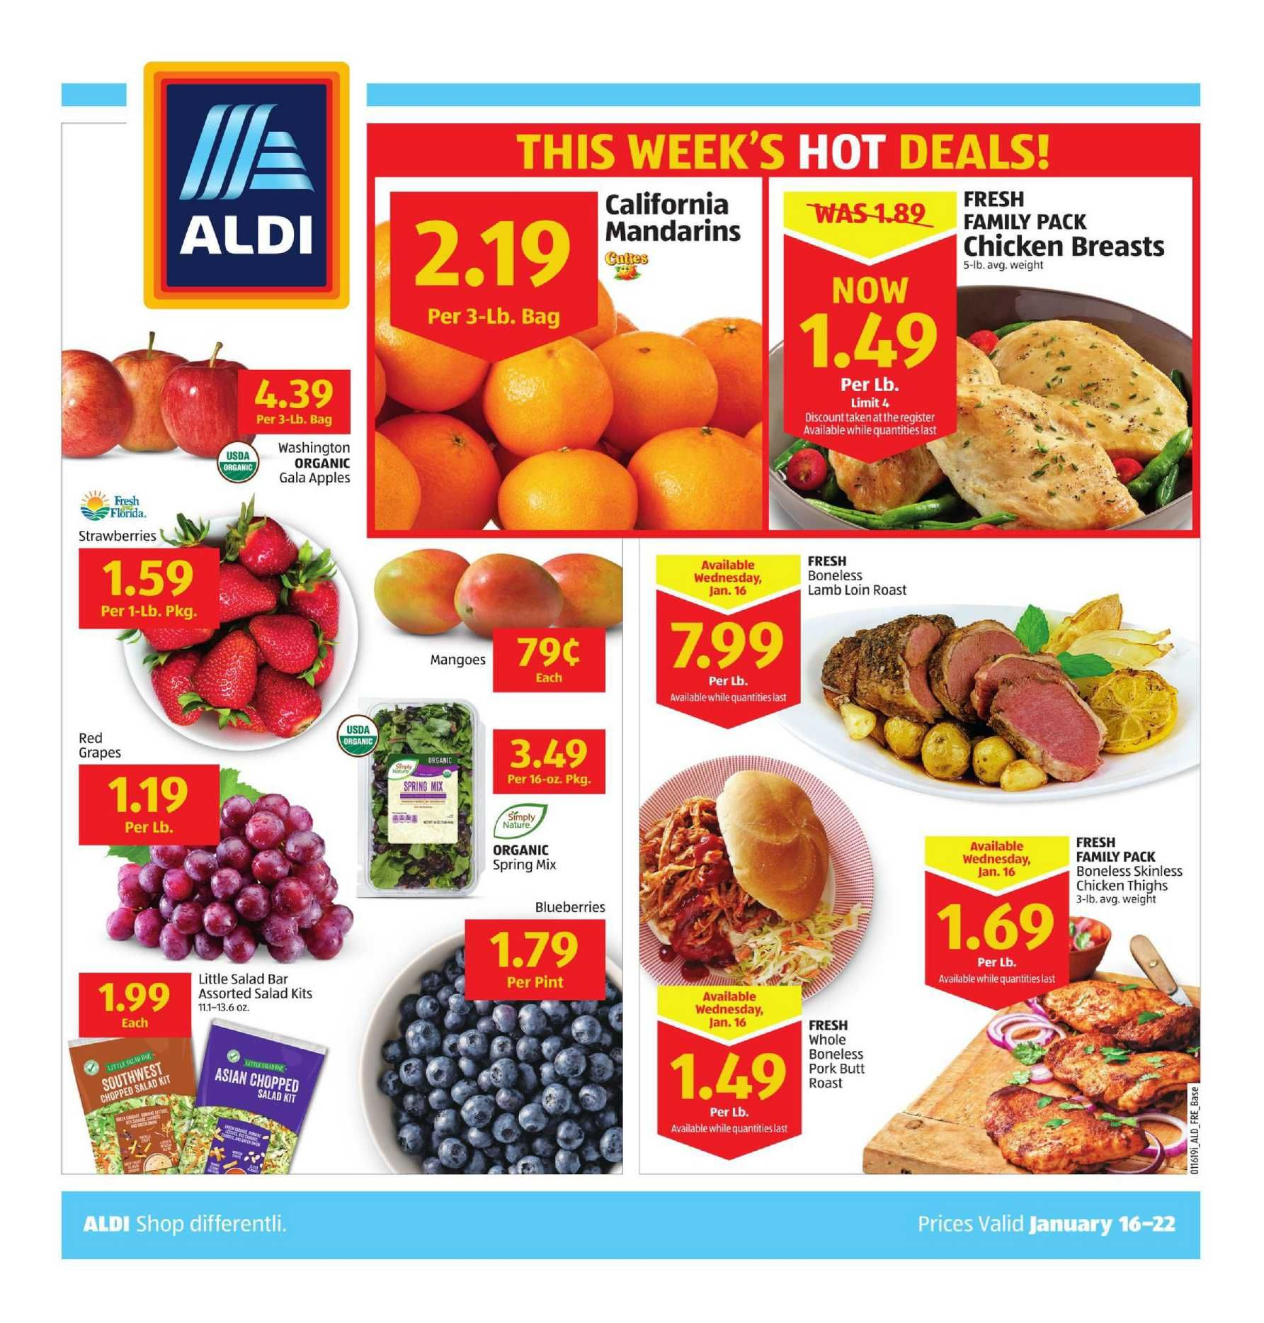
Business Question
Which customers will respond to a marketing campaign?
Why?
We can increase the efficiency of marketing campaigns only marketing to likely customers and therefore reduce expenses
Notes:
What is the response rate of customers to marketing campaigns? i.e. How successful have marketing campaigns been in the past?
What are the top characteristics that help predict a customer’s response?

Slide 4
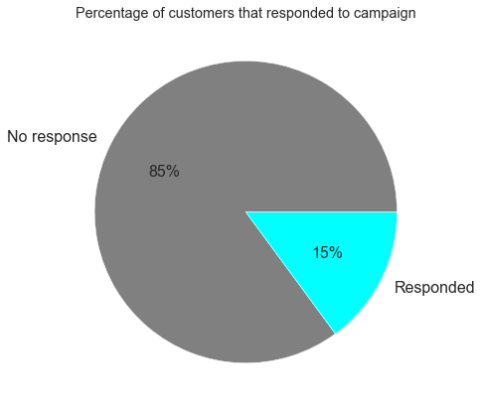
Data summary
Sourced from Kaggle https://www.kaggle.com/rodsaldanha/arketing-campaign/version/8
29 features, 2240 observations
Target: whether the customer responded in the last campaign
Notes:
Original source might be from a book: O. Parr-Rud. Business Analytics Using SAS Enterprise Guide and SAS Enterprise Miner. SAS Institute, 2014.

Slide 5
Data summary
Customer characteristics
Education level
Purchasing behaviour
Date customer enrolled
Recency (days since last purchase)
Income
Dependents
Marital status
Interaction
Amount spent on fish, meat, fruit, sweets, wines, gold
No. of purchases made with discount, catalogue
No. of purchases made in store, on website
No. of visits to website in the last month
Complain in the last 2 years
Accepted offer in the past 5 campaigns

Slide 6
Data pipeline
Define
Prepare
Analyse
Business question
Data sources
Model
Predict
Evaluate
Tune hyperparameters
Deliver
Visualise
Summarise
Advise
Exploratory data analysis
Clean
Remove outliers
Fill in missing values
Dummy variables
Feature engineering
Standardising
Oversampling

Slide 7
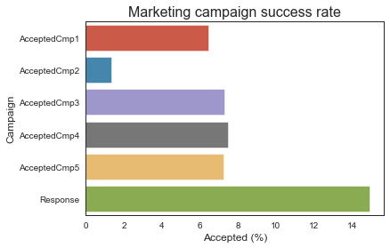
Exploratory Data Analysis
The most recent campaign was the most successful one yet, compared to the past 5 campaigns

Slide 8
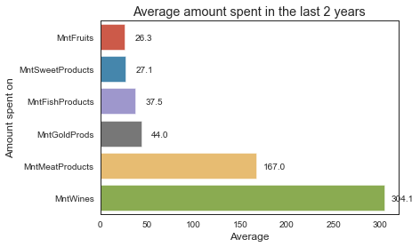
Exploratory Data Analysis
On average, customers are spending a lot more on meat and wine products

Slide 9
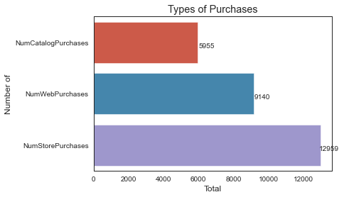
Exploratory Data Analysis
There were more in-store purchases than online or catalogue purchases

Slide 10
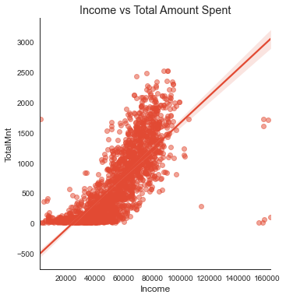
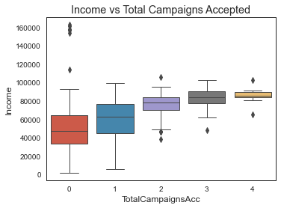
Exploratory Data Analysis

Slide 11
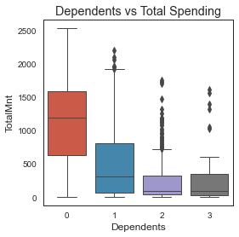
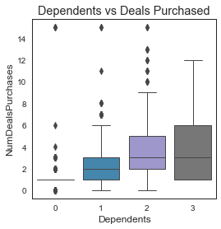
Exploratory Data Analysis

Slide 12
Top 5 features correlated to Response
Number | Feature | Correlation
1 | Total Campaigns Accepted | 0.43
2 | Accepted Campaign 5 | 0.33
3 | Accepted Campaign 1 | 0.29
4 | Total Amount Spent | 0.27
5 | Accepted Campaign 3 | 0.25
Responding to campaigns in the past is correlated to Response
Notes:
Recency = number of days since the last purchase

Slide 13
Data pipeline
Define
Prepare
Analyse
Business question
Data sources
Clean
Remove outliers
Fill in missing values
Dummy variables
Feature engineering
Model
Predict
Evaluate
Tune hyperparameters
Deliver
Visualise
Summarise
Advise
Exploratory data analysis
Standardising
Oversampling
Notes:
Pre-processing: removing outliers, filling in missing values, feature engineering, clean up values in columns, make dummy variables
Standardising the data, oversampling – imbalanced data,

Slide 14
Modelling & Interpretation
 | Precision | Recall | Accuracy
Logistic Regression | 0.53 | 0.79 | 0.84
Support Vector Machine (SVM) | 0.50 | 0.75 | 0.83
Naïve Bayes | 0.47 | 0.61 | 0.82
Random Forest | 0.57 | 0.45 | 0.85
Logistic regression model is recommended due to high recall
Notes:
GridSearchCV with cv=5 was performed to look for the best params for each model.
Recall is important because we don’t want to skip/miss any potential customers that will respond. i.e. we want to minimise the false negatives.

Slide 15
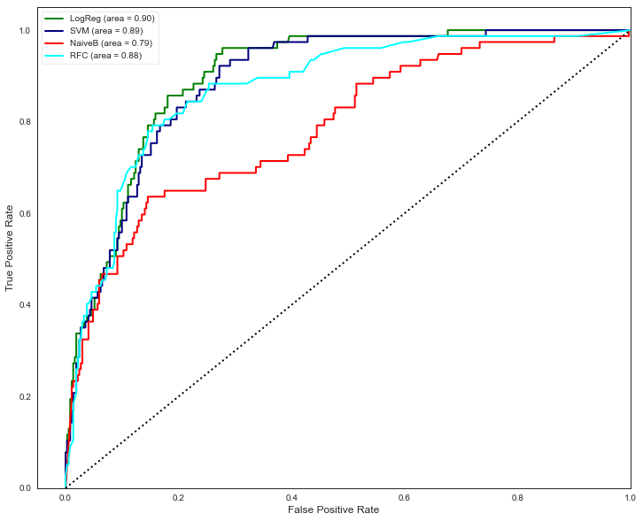
Receiver Operating Characteristic Curve
Notes:
Area Under Curve (AUC) is equal to the probability that the model will rank a
randomly chosen positive instance higher than a randomly chosen negative one.

Slide 16
Summary
The company’s most recent marketing campaign has been the most successful one, compared to the past 5 campaigns
More purchases are made in-store, rather than online or through catalogue
Customers spend the most amount of money of wine and meat products
Responding to past campaigns is correlated with responding to future campaigns
It is recommended that a Logistic Regression model is used to predict which customers will respond to a marketing campaign

Slide 17
Limitations & Next Steps
Limitations:
Not enough context about the company
Not much information about how the marketing campaigns were carried out. What products were being marketed?
Next steps:
Feature selection to reduce complexity
Test whether marketing costs can be reduced by using predictions from the model to target a smaller number of customers
Consider using customer segmentation and targeting groups separately

